Slide 1

Smart Home Asset Locator
Team7 Nikhil Kairamkonda Nikhitha Sadanala Theshitha Vanga Sujith Thanna Samarasimha Reddy Kota Chakradhar Vadlamudi

Slide 2

Introduction
To find objects(Smartphone, Remote , Smartwatch etc.,) by dividing the indoor area such as Kitchen, Bedroom, Living room etc.,.
Wireless technology is an emerging and significant technology that is used for location finding.
GPS can be used to monitor a person outside of a facility, but not within.
The primary driving force behind this is the implementation of a system that can track and locate users within buildings.

Slide 3
Problem & Solution
Current problems:
Orient individuals inside a retail center
Museum tours: Your phone may serve as a virtual guide, providing contextual information based on your location.
Warehouse automation skills have been enhanced.
Airports, hospitals, and hotels are all available. The advantages are comparable to those of the preceding applications.
Guidance to visually impaired : With audible & sensory feedback
Our Solution:
BLE offers better precision and accuracy in asset tracking applications.
Standardization in BLE ensures a more consistent and interoperable approach.
The low power consumption of BLE is advantageous for prolonged operation in battery-powered devices.
The use of beacons enhances the simplicity and efficiency of BLE-based asset tracking implementations.
BLE emerges as a standardized solution for asset tracking, overcoming some limitations associated with raw RSSI measurements.

Slide 4
Proposal-Smart Home Asset Locator
To achieve accurate location of a device indoor using smart devices like BLE.

Slide 5
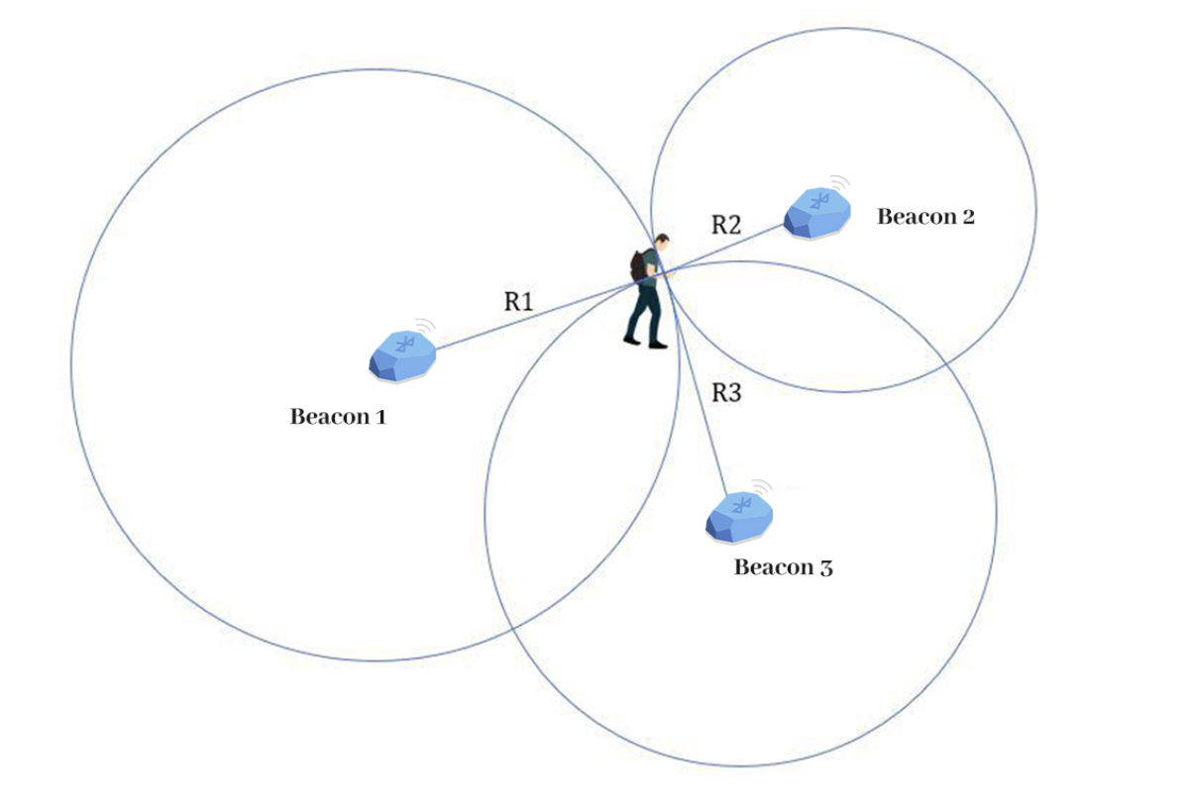
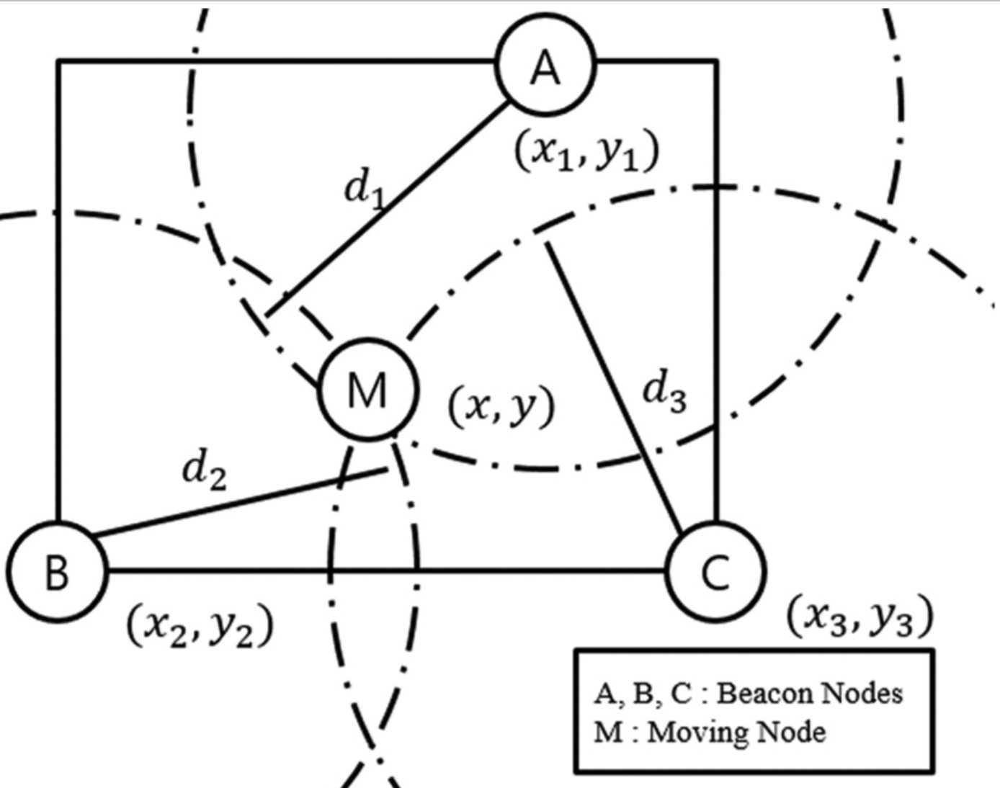
BLE Triangulation
BLE Triangulation Fundamentals: BLE triangulation entails calculating a device's position by analyzing signals from numerous Bluetooth Low Energy (BLE) beacons.
The approach is based on monitoring the Received Signal Strength Indicator (RSSI), which indicates how strong the BLE signals are when received by the device.
Distance Estimation: The RSSI-distance relationship is utilized to calculate how distant the device is from each beacon.
Trilateration: Trilateration calculates the device's position by using signals from at least three beacons, with trilateration locating the place where the circles (indicating beacon distances) connect.
Algorithmic Considerations: To improve accuracy in computing the device's position, several algorithms, including those that use signal attenuation models and environmental conditions, are used.

Slide 6
Application Usage
Indoor Positioning and Real-Time Location Systems (RTLS)
Automotive
Healthcare
Smart Homes and IOT
Construction and surveying
Robotics and drones
Security and access control
Asset Tracking and Inventory Management
Smart Cities

Slide 7
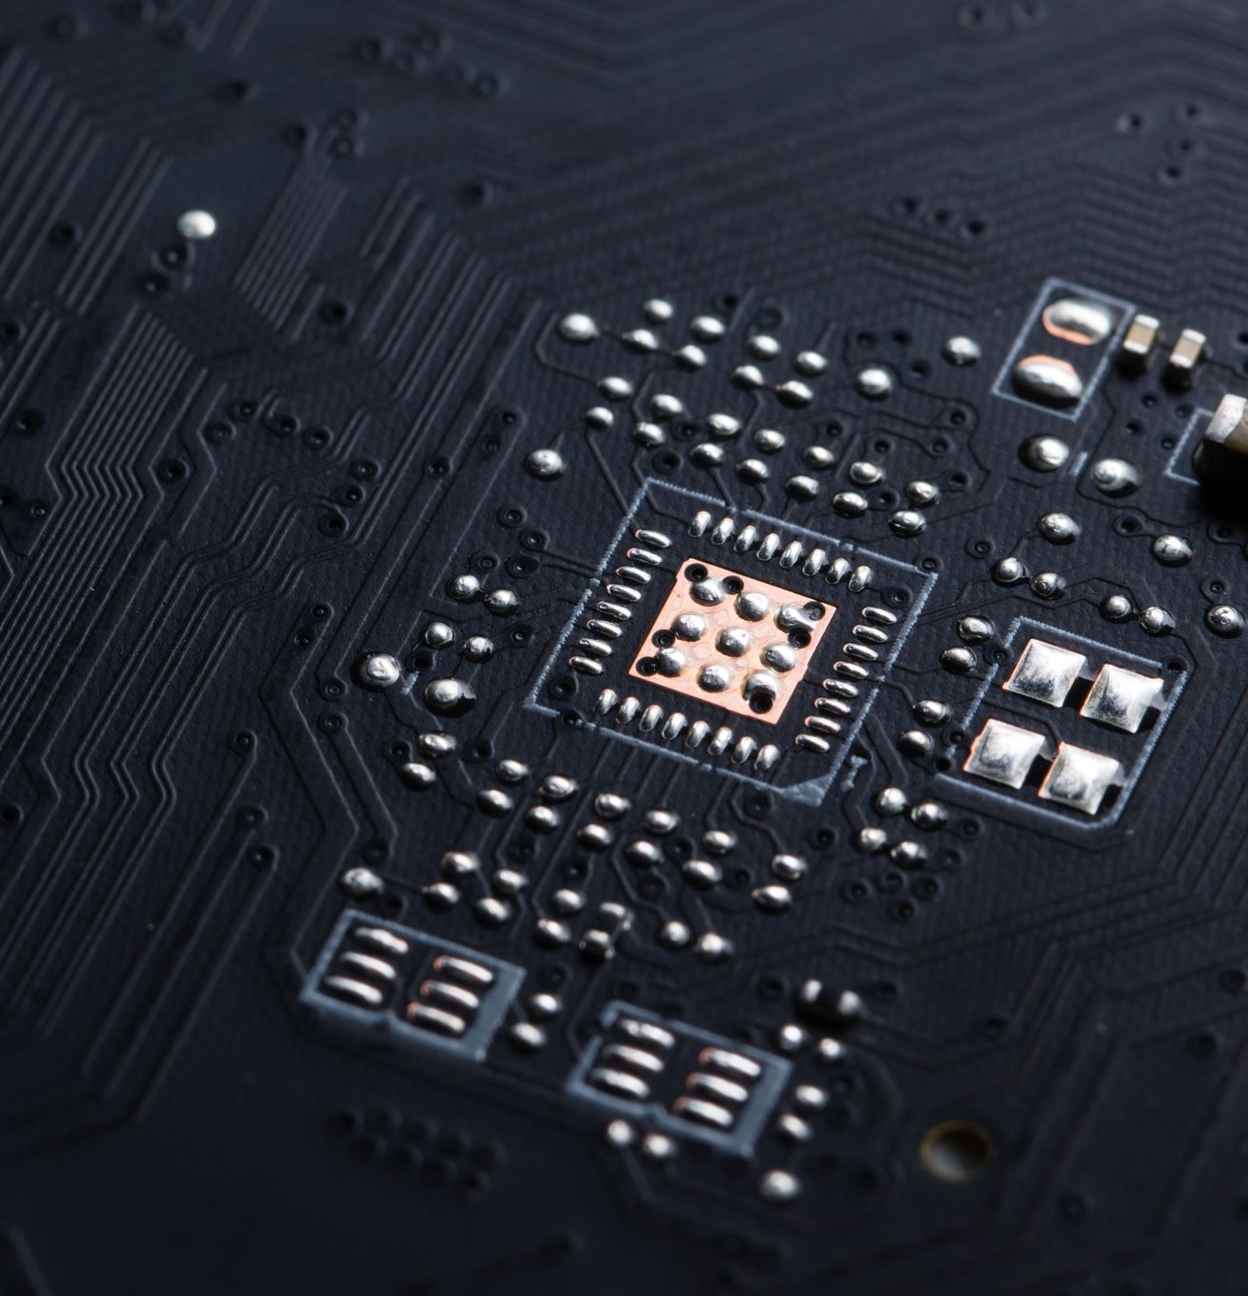
Technologies Used
Alexa
Arduino
Python
ESP32

Slide 8
Flow Diagram
01
User Request
Sending Beacons and Measuring the time taken to receive the response.
Estimate Distance
02
Locating accurate location using BLE Triangulation
03
Estimate Position
Inform Alexa
04
05
Result

Slide 9
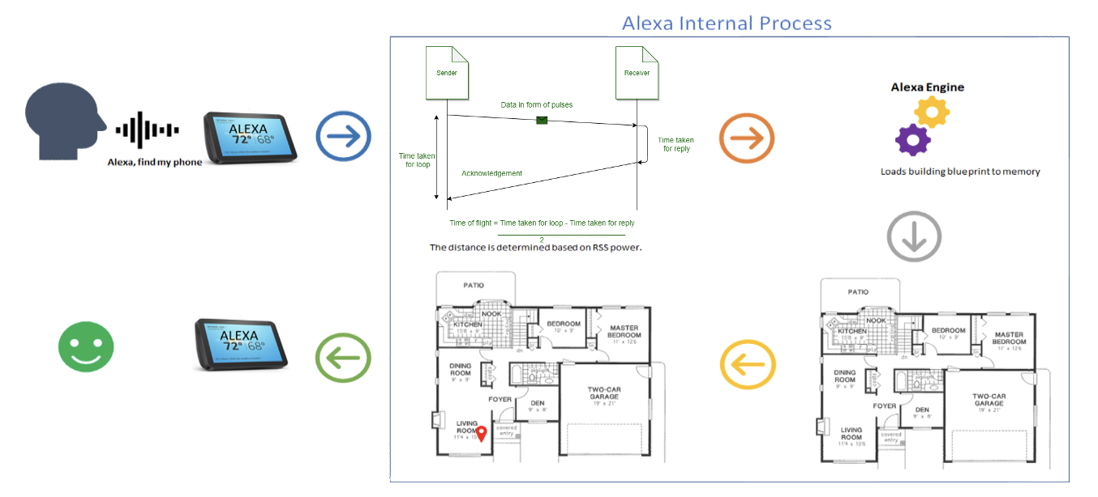
Block Diagram

Slide 10
Problems Anticipated
The transmission distance of BLE Bluetooth is limited, the user must be within a specific distance of the Bluetooth beacon's position
Non-stationary objects such as doors, furniture, and people can pose an even greater problem, as they can affect the signal strength in dynamic, unpredictable ways.

Slide 11
Thank You🙏

